Slide 1

Project Report on
Crowd monitoring and safety analysis
Submitted in partial fulfillment of the requirements of the degree of Bachelor in Engineering
by
Name of Student Class Roll No.
Darshan Nemade BE-4 25
Paras Thakur BE-3 80
Ulkesh More BE-3 73
Under the guidance of
Ms. VAISHALI CHAVAN
DEPARTMENT OF COMPUTER ENGINEERING
SHAH AND ANCHOR KUTCHHI ENGINEERING COLLEGE CHEMBUR,
MUMBAI - 400088.
2020-2021

Slide 2

Crowd monitoring and safety analysis

Slide 3
Motivation
It has been observed that in spite of the presence of several secured surveillance systems in place, several untoward incidents such as thefts, robbery, terror plots, crowded gathering, etc take place. The video footage in such cases are mostly used for post-mortem analysis rather than preventing the untoward incident from happening. This serves as a motivation to develop a computer vision based smart system to detect and alert anomalous activities instantaneously and automatically without any human intervention. With this motivation a Computer Vision Based Anomaly Detection System (CVADS) is proposed which automatically detects anomalies such as presence of masked faces, anomalous activities that may result in security threat and detecting abandoned objects. This system automatically detects the anomalies ,crowded scenes without any intervention of security persons and sends instantaneous security alerts.

Slide 4
What are Anomalies ?
What are Anomalies
something that is different from what is normal or usual.
It is a tedious task to recognize abnormal activities due to its infrequent occurrence in the crowd.
Anomalies that we try to detect are:
Crowded scenes .
Unusual behavior .

Slide 5


Problem statement
The aim of this research work is to design a Computer vision based anomaly detection system using smart anomaly detection algorithms to promote better and smart surveillance system without any human intervention.
To learn and recognize the collective behavior for anomaly detection.

Slide 6
Objective
01
02
03
04
To provide high degree of accuracy in anomaly detection.
To maintain minimal misclassification rate.
To improve response time in terms of both anomaly detection and alerting.
To improve anomaly detection in occlusion conditions

Slide 7
Dataset
We train our model on five most commonly used benchmarking datasets: Avenue , UCSD Ped1 and Ped2, Subway entrance and exit datasets .All videos are taken from a fixed position for each dataset. All training videos contain normal events. Testing videos have both normal and abnormal events.
In Avenue dataset, there are total 16 training and 21 testing video clips. Each clips duration vary between less than a minute to two minutes long. The normal scenes consist of people walking between staircase and subway entrance,whereas the abnormal events are people running, walking in opposite direction, loitering and etc. The challenges of this dataset include camera shakes and few outliers in the training data. Also, some normal pattern seldom appears in the training data.
UCSD Ped1 dataset has 34 training and 36 testing video frames, where each clip contains 200 frames. The videos consist of groups of people walking towards and away from the camera. UCSD Ped2 dataset has 16 training and 12 testing video frames, where the number of frames of each clip varies. The videos consist of walking pedestrians parallel to the camera plane. Anomalies of the two datasets include bikers, skaters, carts, wheelchairs and people walking in the grass area.
Crowded dataset which includes 8 abnormal videos.

Slide 8
Methodology
The method described here is based on the principle that when an abnormal event occurs, the most recent frames of video will be significantly different than the older frames. Inspired by , we train an end-to-end model that consists of a spatial feature extractor and a temporal encoder-decoder which together learns the temporal patterns of the input volume of frames. The model is trained with video volumes consists of only normal scenes, with the objective to minimize the reconstruction error between the input video volume and the output video volume reconstructed by the learned model. After the model is properly trained, normal video volume is expected to have low reconstruction error, whereas video volume consisting of abnormal scenes is expected to have high reconstruction error. By thresholding on the error produced by each testing input volumes, our system will be able to detect when an abnormal event occurs.

Slide 9
Preprocessing
Resize to 227*227
Rescale pixel values b/w 0 to 1.
Calculate mean Image
Subtract Mean Image
Convert to Grayscale
Normalized to zero mean and unit variance.

Slide 10
Feature Learning
Autoencoder : convolutional spatiotemporal autoencoder to learn the regular patterns in the training videos. Our proposed architecture consists of two parts— spatial autoencoder for learning spatial structures of each video frame, and temporal encoder-decoder for learning temporal patterns of the encoded spatial structures.
Spatial Convolution : The primary purpose of convolution in case of a convolutional network is to extract features from the input image. Convolution preserves the spatial relationship between pixels by learning image features using small squares of input data.
Recurrent Neural Network (RNN) : RNN works just like a feedforward network, except that the values of its output vector are influenced not only by the input vector but also on the entire history of inputs. In theory, RNNs can make use of information in arbitrarily long sequences, but in practice, they are limited to looking back only a few steps due to vanishing gradients.

Slide 11
Feature learning
Long Short Term Memory (LSTM): long short term memory (LSTM) model which incorporates a recurrent gate called forget gate. With the new structure, LSTMs prevent backpropagated errors from vanishing or exploding, thus can work on long sequences and they can be stacked together to capture higher level information.
Convolutional LSTM : Compared to the usual fully connected LSTM (FC LSTM), ConvLSTM has its matrix operations replaced with convolutions. By using convolution for both input-to-hidden and hidden-to-hidden connections, ConvLSTM requires fewer weights and yield better spatial feature maps

Slide 12
Regularity score
Once the model is trained, we can evaluate our models performance by feeding in testing data and check whether it is capable of detecting abnormal events while keeping false alarm rate low. To better compare with [5], we used the same formula to calculate the regularity score for all frames, the only difference being the learned model is of a different kind. The reconstruction error of all pixel values I in frame t of the video sequence is taken as the Euclidean distance between the input frame and the reconstructed frame.
e(t)∥x(t) − fW(x(t))∥2

Slide 13
Software required
Visual Studio 2012
Various Dependencies and library based Dependencies such as
ffmpeg for Video frame extraction.
numpy
sklearn
keras
tensorflow
h5py
scipy
OpenCV

Slide 14
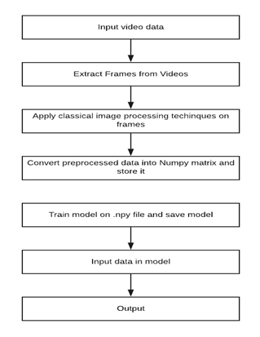
Block diagram

Slide 15
Working
Data Pre-Processing – STEP 1
Download the videos ie; 16 training videos and 12 testing videos and divide it by frames.
Images with random objects in the background.
Various background conditions such as dark, light, indoor, outdoor, etc.
Save all the images in a folder called images and all images should be in .jpg format.
Use Argprase parser to add argument to the file names.
Divide each and every video into frames and save the frames in a directory separated by the type of anomaly or situation as well as resize the images to scale.
Reshape and normalize the images.
Clip negative values and remove buffer directory.

Slide 16
Working
STEP 2 : Loading the Keras Models
Import the three models given below:
Convolutional 3DConvolutional LSTM 2D
Convolutional 3D Transpose
Using Sequential define filters, padding and activation of these models. I am choosing Relu.
Let the optimizer be Adam and metric loss be Categorical Crossentropy.
STEP 3 : Training the Model
train.py which runs the training process
pipeline_config_path=Path/to/config/file/model.config
model_dir= Path/to/training/
If the kernel dies, the training will resume from the last checkpoint. Unless you didn’t save the training/ directory somewhere, ex: GDrive.
If you are changing the below paths, make sure there is no space between the equal sign = and the path.
And use early Callbacks to stop the training if it goes out of hand.

Slide 17
Working
Step 4: Export the Trained Model
The model will save a checkpoint every 600 seconds while training up to 5 checkpoints. Then, as new files are created, older files are deleted.
A file called model.h5 is created which will be used while testing later.
Epochs were used as arg.epoch and batch size for training was 32.
Another file called training.npy would be created it contains the array form of all the coordinates required while testing. SO here no frozen inference graph or pdtxt file is created.
Step 5: Testing the Detector
Load the model.h5 file and training.npy file.
Test the Videos as: Anomalous Bunch of Numbers, Whether it is normal or abnormal

Slide 18
Applications
Intrusion detection: The key challenge for anomaly detection in this domain is the huge volume of data. Thus, semi-supervised and unsupervised anomaly detection techniques are preferred in this domain.
Fraud Detection: Fraud detection refers to detection of criminal activities occurring in commercial organizations such as banks, credit card companies, insurance agencies, cell phone companies, stock market, etc. The organizations are interested in immediate detection of such frauds to prevent economic losses.
Medical and Public Health Anomaly Detection: Anomaly detection in the medical and public health domains typically work with patient records. The data can have anomalies due to several reasons such as abnormal patient condition or instrumentation errors or recording errors. Thus the anomaly detection is a very critical problem in this domain and requires high degree of accuracy.

Slide 19
Applications
Industrial Damage Detection: Such damages need to be detected early to prevent further escalation and losses.
Image Processing: Anomaly detection techniques dealing with images are either interested in any changes in an image over time (motion detection) or in regions which appear abnormal on the static image. This domain includes satellite imagery.
Sensor Networks: Since the sensor data collected from various wireless sensors has several unique characteristics.

Slide 20
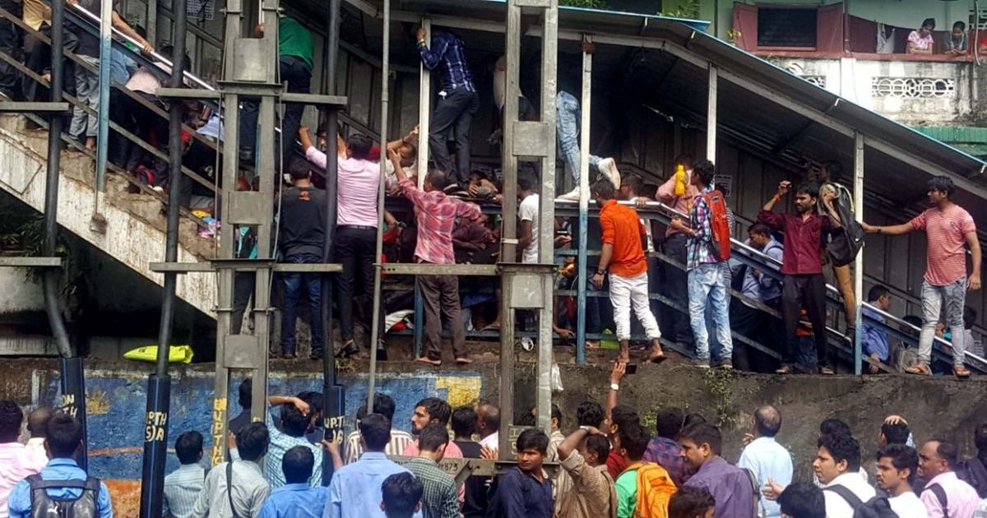

Crowd Disaster
According to the National Crime Records Bureau figures, from 2000 to 2021, almost 6,000 people died in stampedes.
A 2018 study published by International Journal of Disaster Risk Reduction (IJDRR) points out that religious gathering and pilgrimages have been venues for 79% of the stampedes in India.
On 29 September 2017, a stampede broke out at the sub-urban Elphinstone Road railway station in Mumbai, India. At least 23 people were killed and 39 others were injured in the stampede.

Slide 21
Future scope
For future work, we will investigate how to improve the result of video anomaly detection by active learning having human feedback to update the learned model for better detection and reduced false alarms. One idea is to add a supervised module to the current system, which the supervised module works only on the video segments filtered by our proposed method, then train a discriminative model to classify anomalies when enough video data has been acquired.

Slide 22
References
Zhao Bin, Li Fei , and Xing E. P. “Online detection of unusual events in videos via dynamic sparse coding,” IEEE Conference on Computer Vision and Pattern Recognition, pp. 3313–3320, 2011.
Cong Yang, Yuan Junsong, and Liu Ji “Sparse reconstruction cost for abnormal event detection,” IEEE Conference on Computer Vision and Pattern Recognition, pp. 3449–3456, 2011.
Chen Zhu, and Saligrama V. “Video anomaly detection based on local statistical aggregates,” Computer Vision and Pattern Recognition, pp. 2112–2119, 2012.
Zhou Xu Gang, Zhang Li Qing “Abnormal Event Detection Using Recurrent Neural Network,” International Conference on Computer Science and Applications,pp. 222–226, 2015.
Sabokrou M., Fathy M., and Hoseini M. “Video anomaly detection and localisation based on the sparsity and reconstruction error of auto-encoder,” Electronics Letters, vol. 52, no. 13, pp. 1122–1124, 2016.
Xu Dan, Ricci Elisa, Yan localization, Song Jingkuan, and Sebe Nicu “Learning Deep Representations of Appearance and Motion for Anomalous Event Detection,” BMVC , 2015.
Hasan Mahmudul, Choi Jonghyun, Neumann Jan, Roychowdhury Amit K., and Davis Larry S. “Learning Temporal Regularity in Video Sequences,” Computer Vision and Pattern Recognition , pp. 733–742,2016.
Ravanbakhsh Mahdyar, Nabi Moin, Sangineto Enver, Marcenaro Lucio, Regazzoni Carlo, and Sebe Nicu “Abnormal Event Detection in Videos using Generative Adversarial Nets,” International Conference on Image Processing, 2017.

